Slide 1
IBM University Engagement Project Submission
"Exploring the Power of Agentic AI with IBM Granite and Spring Boot"

Slide 2

Project Title: AI-Powered Interview Trainer Agent
Domain of Project – Education / Career Tech
Student Name | Recent Passport Photo | Email ID | Mobile number [WhatsApp]
KRISHNENDU CHAKRABORTY |  | chakrabortykrishnandu49@gmail.com | 7001555286
Recommended font style and size: Font Style: Arial Font Size (Heading): 28
Font Size (Content): 20

Slide 3
Problem Statement -
Problem Statement : Interview Preparation
The Challenge
Job seekers, especially fresh graduates, often struggle with technical interviews due to a lack of realistic practice, personalized feedback, and confidence. Traditional mock interviews are expensive, hard to schedule, and lack objective, data-driven skill gap analysis.
The Objective
Build an AI-powered Interview Trainer Agent that delivers dynamic, personalized technical interview practice. The solution should:
Resume & JD Analysis – Compare a candidate's uploaded resume with a target Job Description to identify missing skills.
Dynamic Question Generation – Generate customized, technical interview questions based on the candidate's target skill and difficulty level.
Interactive Voice & Text Practice – Allow users to answer questions using speech-to-text or typing.
Real-time AI Evaluation – Provide instant, objective scoring (0-100) and actionable feedback on the candidate's answers.
Performance Dashboard – Track interview scores over time to visualize progress and readiness.

Slide 4
Proposed Solution -
Proposed Solution: AI-Powered Interview Trainer Agent
The proposed solution is a full-stack, AI-driven mock interview platform built using React, Spring Boot, and IBM watsonx.ai (Granite 3) to provide personalized, real-time interview practice.
At its core, the solution utilizes a seamless API pipeline where a React frontend captures user voice/text inputs and communicates with a secure Java Spring Boot backend. The backend orchestrates interactions with the IBM Granite-3-8b-instruct model to analyze skills, generate dynamic technical questions, and objectively evaluate the candidate's answers.
Key Features:
Resume Parsing & Gap Analysis: Extracts skills from a user's resume (PDF or text) and compares them against a Job Description to highlight skill gaps.
Dynamic Interview Engine: Generates highly specific technical questions (e.g., React Hooks, Java Microservices) on demand.
Real-Time Evaluation: Evaluates candidate answers against expected key points, returning a confidence score and constructive feedback.
Interactive UI: A "gigantic", heavily animated user interface built with Framer Motion, featuring a glowing voice-recording microphone and fluid chat bubbles.
Progress Tracking: A secure MySQL database stores historical performance, rendered on a beautiful analytics dashboard using Recharts.
Overall, this solution delivers an end-to-end intelligent career assistant that promotes confidence and technical readiness through personalized insights and real-time feedback.

Slide 5
Technology Used
IBM Granite Model - ibm/granite-3-8b-instruct – Used for natural language understanding, skill gap analysis, question generation, and complex answer evaluation.
IBM watsonx.ai - Provides the secure, scalable API endpoint for model deployment and AI governance.
Java & Spring Boot - Powers the robust, secure backend infrastructure, managing REST APIs, database connections, and intelligent fallback systems for LLM parsing.
React & TailwindCSS - Powers the responsive, animated, and highly interactive frontend dashboard.
Framer Motion - Used for fluid, physics-based UI animations (staggered entrances, sliding chat bubbles).
MySQL & Hibernate - Used for persistent storage of user profiles and historical interview scores.

Slide 6
AI Components Used
Resume & JD Input: Interface where users upload their resume
(PDF/Text) and target job description.
IBM watsonx AI Agent (Backend Controller): Processes user input using
Granite models via Spring Boot to generate custom questions and skill gap
reports.
Name of IBM Granite model: ibm/granite-3-8b-instruct → Fast, efficient,
and highly capable of adhering to strict JSON outputs for seamless
backend integration.
Chat Output / Evaluator: Displays AI-generated interview questions and
provides instant score-based feedback (0-100) on user answers.
Speech-to-Text Integration: Web Speech API utilized on the frontend to
allow natural, verbal interview responses.

Slide 7
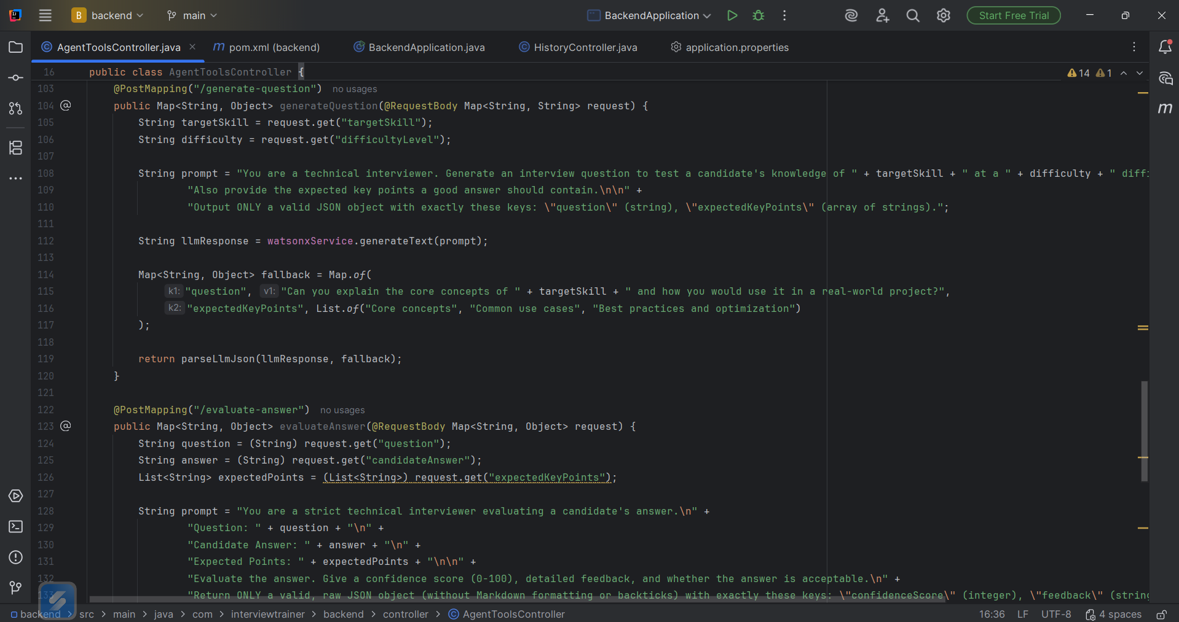
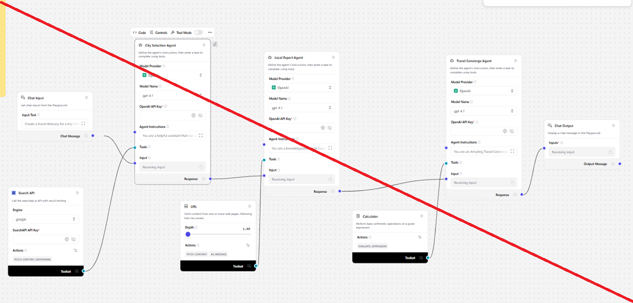
Backend AI Orchestration (Spring Boot)

Slide 8
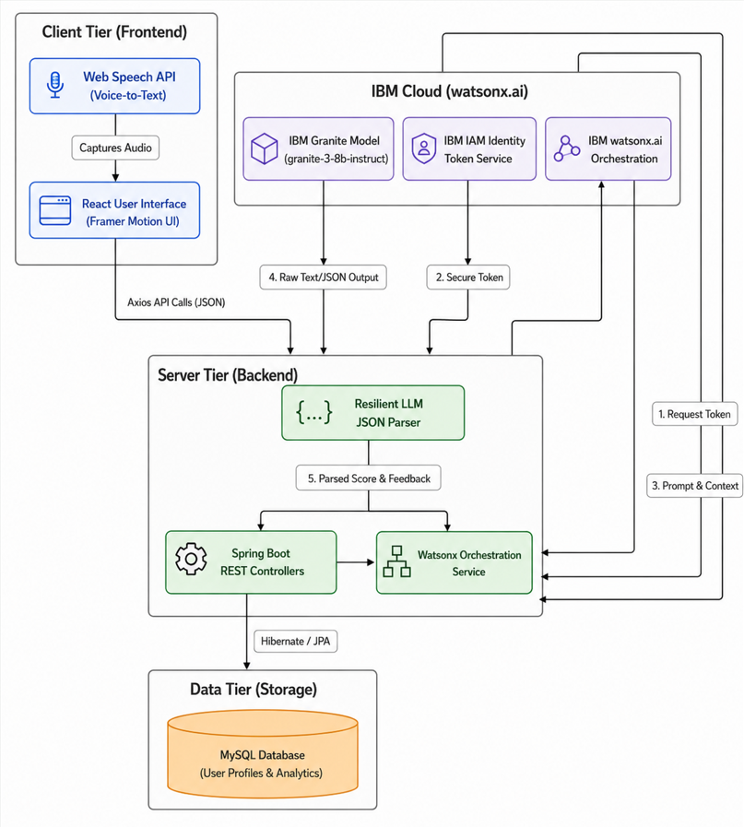
Architecture blueprint

Slide 9

Role of Agentic AI in the solution
Agentic AI enables the Interview Trainer to function as an intelligent, autonomous technical interviewer rather than a simple chatbot. Using IBM watsonx.ai and IBM Granite models, the system dynamically adapts to the user.
Instead of a static list of questions, the AI acts as an active evaluator. It understands context (the user's chosen skill and difficulty level), generates a unique question, and establishes "Expected Key Points" hidden from the user. When the user answers, the AI autonomously compares the response against those key points to generate an objective score and tailored feedback.
The system also includes Resilient Fallback Mechanisms in the backend; if the AI encounters an error or network limit, the backend autonomously recovers to ensure a seamless user experience.
Overall, Agentic AI makes the system proactive and adaptive, acting like a real-world hiring manager that helps users improve their communication and technical skills.

Slide 10
Novelty and Uniqueness
The proposed Interview Trainer Agent stands out by combining Generative AI, Voice Interaction, and Full-Stack Engineering into a single intelligent system.
Dynamic Questioning: Instead of hardcoded questions, every interview session is uniquely generated based on the specific skill and difficulty selected.
Objective AI Evaluation: The system doesn't just chat; it grades answers on a 0-100 scale based on predefined "Key Points," providing measurable metrics for improvement.
Robust Backend Architecture: Unlike simple frontend wrappers, this uses a Java Spring Boot backend with intelligent JSON parsing and error-fallback mechanisms for enterprise-grade reliability.
Multi-Modal Input: Supports seamless typing and voice-to-text recording, simulating a real verbal interview environment.
Premium UX/UI: Features "gigantic" modern styling, frosted glassmorphism, and fluid Framer Motion animations for a highly engaging user experience.
This makes the solution a smart, adaptive, and proactive career coach, not just a static quiz app.

Slide 11
Git Hub Link
https://github.com/KrishnenduChakraborty49/Interview-Trainer-Agent.git
·
·
·

Slide 12
Future Scope
Video & Facial Expression Analysis – The system can be integrated with computer vision libraries (like OpenCV or WebRTC) to record and analyze a candidate's webcam feed during the interview. By monitoring facial expressions, eye contact, posture, and micro-expressions, the AI can provide comprehensive feedback on non-verbal communication skills. This would allow the Agent to train candidates not just on what they say, but how they present themselves, making the mock interview exponentially more realistic.
AI-Powered Voice Synthesis & Multi-Lingual Support – Currently, the user speaks to the AI, but the AI replies via text. Enhancing the system with advanced Text-to-Speech (TTS) models would give the AI interviewer a realistic, human-sounding voice, creating a fully immersive conversational experience without the need to read the screen. Additionally, integrating real-time translation agents would allow the Interview Trainer to conduct mock interviews in multiple languages, making it a globally accessible tool for non-native English speakers preparing for international roles.
·
·
·

Slide 13
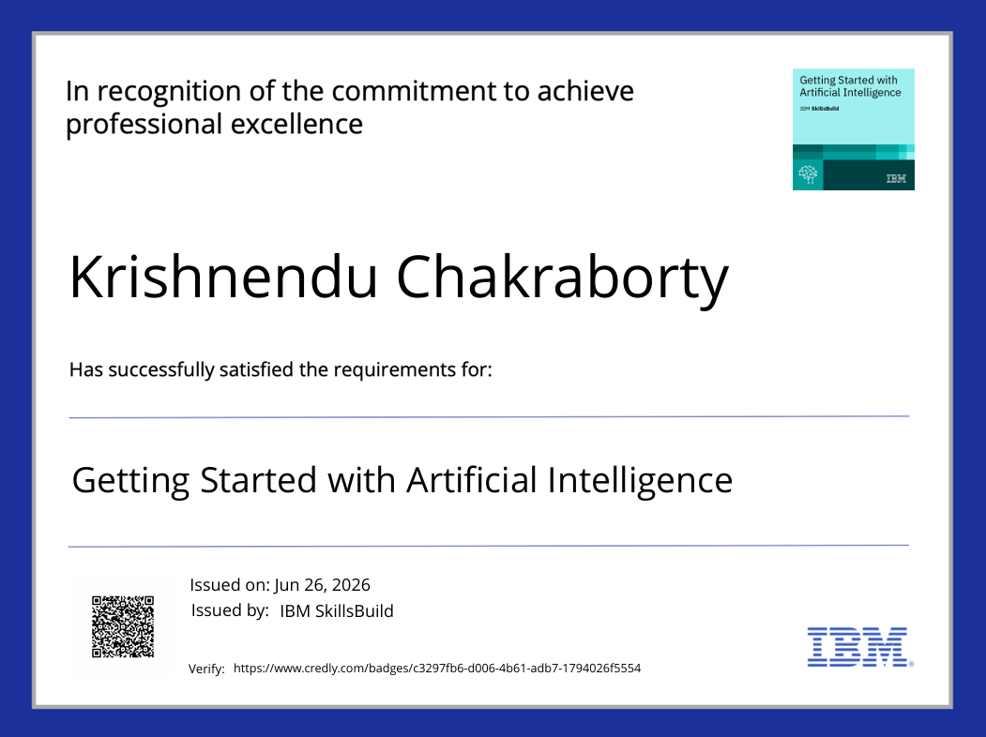
Certificates Earned:

Slide 14
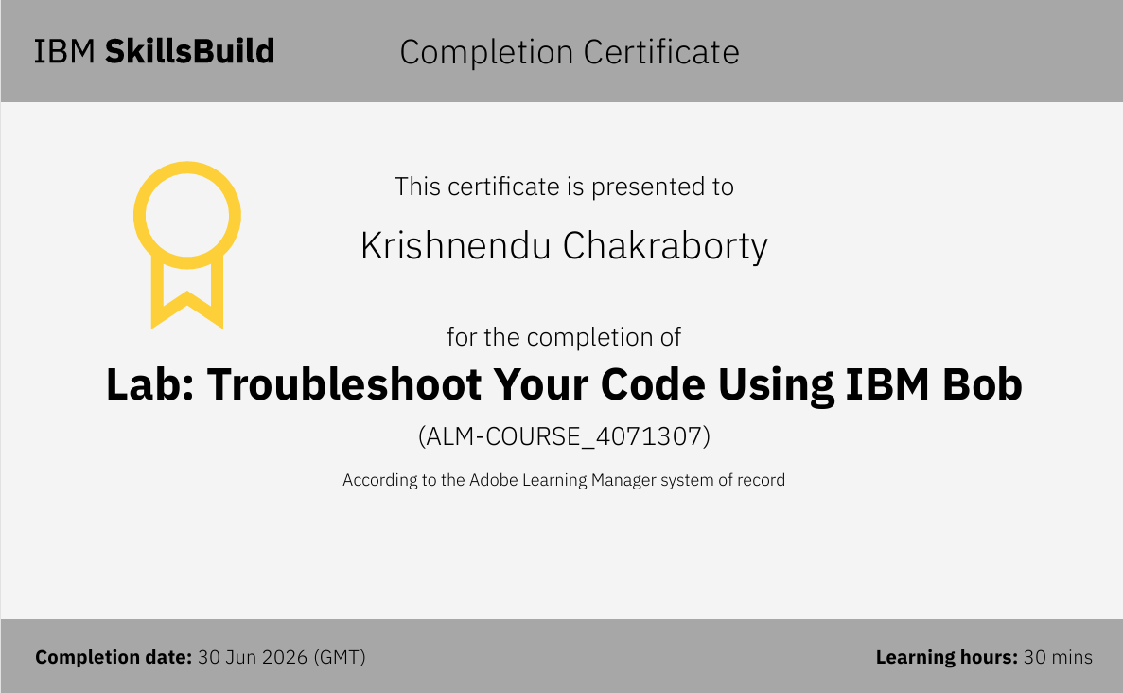
Certificates Earned:​

Slide 15


